Slide 1
Midterm Report PV power matching
Leander Merbeck
12.11.2024
HÍ – Design Optimization

Slide 2




PV panel modeling
N
x
z
$$φ$$
W
y
$$η$$
x
$$τ$$
$$τ$$
S

Slide 3



Sun modeling
Ephemeris data?
S
$$η$$
E
$$α$$
W
N

Slide 4
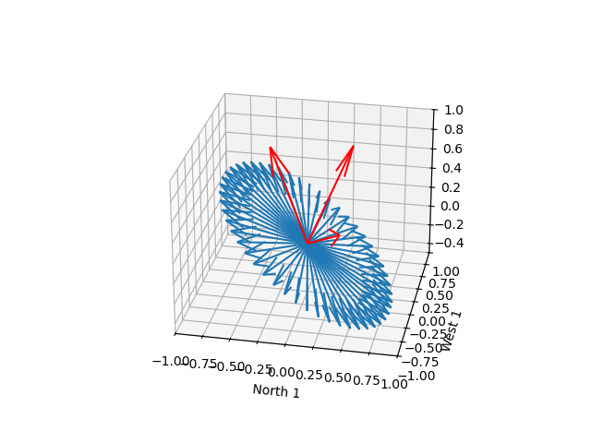


Panel-sun-angle influence
$$θ$$
$$f_{θ}=\cos{θ}$$
Additional checks for:
Sun below horizon
Sun behind panel

Slide 5

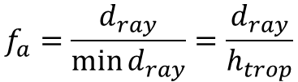



Atmospheric modeling
$$f_{a}=\frac{d_{ray}}{\min{d_{ray}}}=\frac{d_{ray}}{h_{trop}}$$
$${\left(r_{e}+h_{trop}\right)}^{2}=r_{e}^{2}+d_{ray}^{2}−2⋅d_{ray}⋅r_{e}⋅\cos{η}$$
$$d_{ray}$$
$$h_{trop}$$
$$η$$
$$r_{e}$$

Slide 6
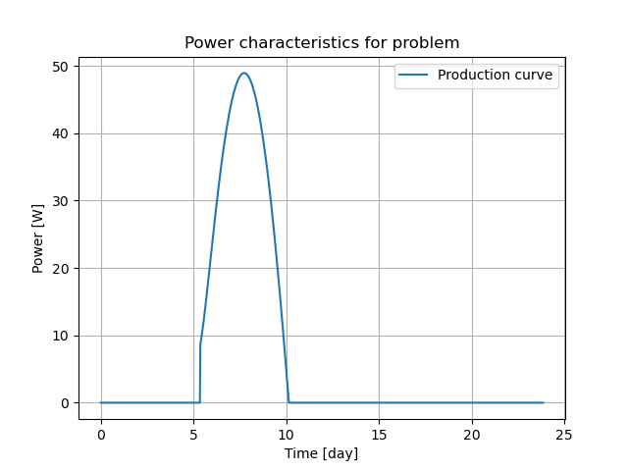
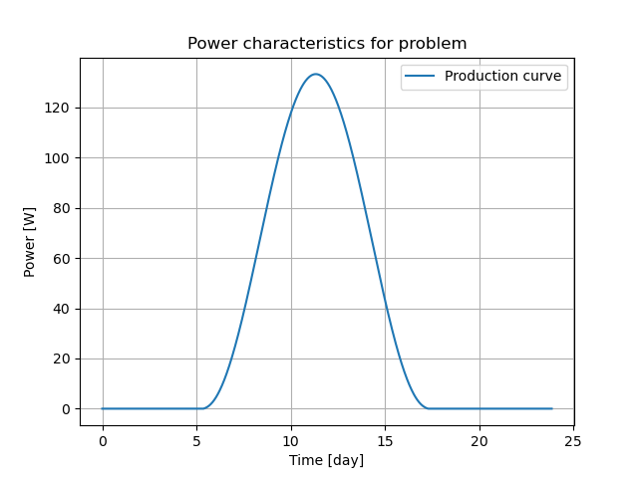
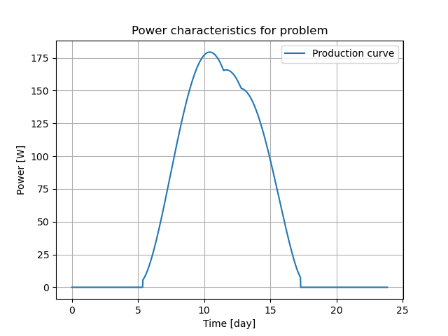

Panel power characteristic
$$P_{panel}=f_{θ}⋅f_{a}⋅P_{max}$$

Slide 7
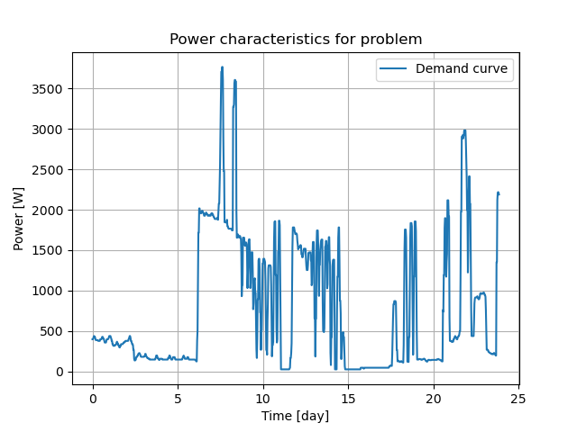
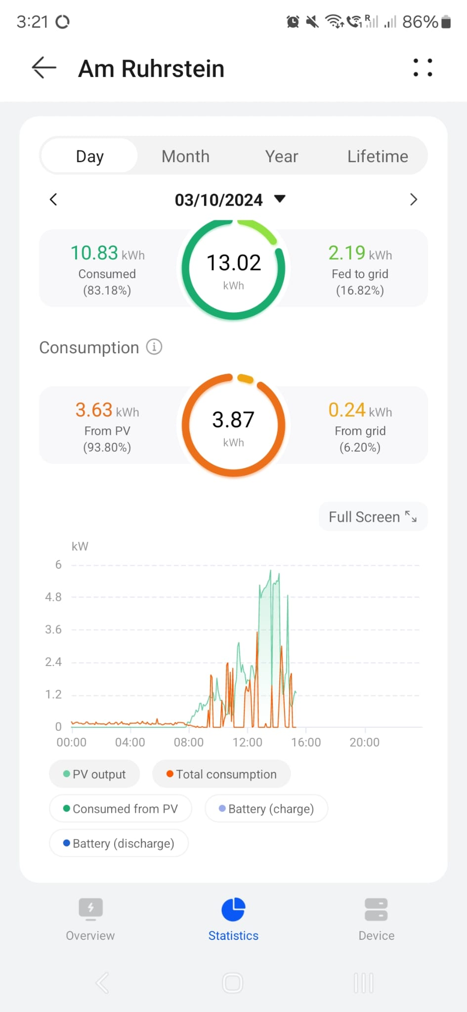
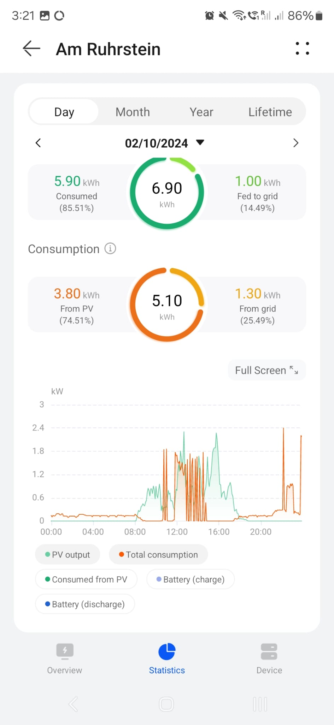
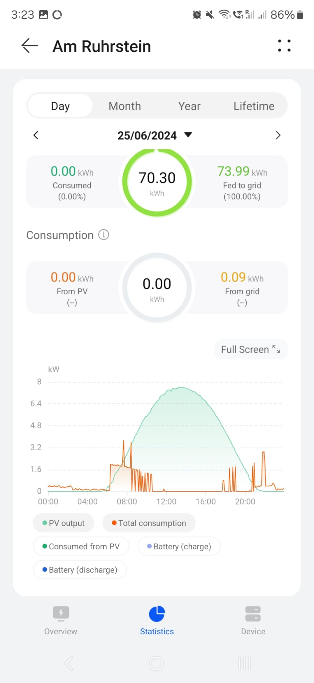
Demand characteristic

Slide 8
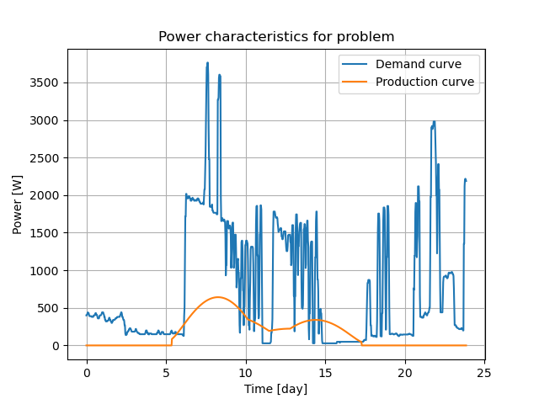



Production and demand matching
Criteria
SSE
Cost function minimization
$C_{t}=c_{grid}E_{bought} −c_{prod}E_{sold}$
$$P_{bought}$$
$$P_{sold}$$

